Slide 1


Project Title
Matrimony Service

Slide 2
Presented By
Name : Nafizul Islam
ID : 193-35-480
Department of Software Engineering
Daffodil International University
Supervised By
Mr. S A M Matiur Rahman
Associate Professor
Department of Software Engineering
Daffodil International University

Slide 3
Introduction
Page: 01

Slide 4
Project Overview
The Matrimony Web Application is to provide Grooms and Brides
with excellent matchmaking experience by exploring the opportunities and resources to meet true potential partner. It is for people of all religions in whole Bangladesh.
Page: 02

Slide 5
Purpose of our web
The main purpose of this application is to facilitate matchmaking by
applying the information in the field.
It helps the user by providing profiles of perspective “Bride” or “Groom” and other information regarding them online.
User can get information regarding their dream life partner at his/her home at his/her convenience.
This application also provides a search utility which helps those users
who have a certain criteria of qualities in mind to make online
matrimonial easier.
Page: 03

Slide 6
The new features that the user
will benefit from
Secular
Contact Profile Without Account
Without Registration one kind view others profile
Money Transaction without package / Contact Profile Without package
Page: 04

Slide 7
Functional Requirements
Page: 05

Slide 8
Functional Requirements
Visitor Activities
Register and login usability
Searching by userID.
By selecting many options, any user/visitor can easily find the partner of his choice.
My Account
Edit Profile
Can profile photo upload.
Can profile update
Change Password
Page: 06

Slide 9
Non-functional Requirements
Page: 07

Slide 10
Non functional Requirements
Easy to use, efficient, and accessible
Associate every Biodata Post with an account.
Keep track of biodata, activities, and responses.
Customer & User Security.
Verification .
Page: 08

Slide 11
Use Case Diagram
Page: 09

Slide 12
Registration
Use Case Diagram - Admin
Login
Active Account
Deactivate Account
Member
My Account
Post Biodata
Admin
View Profile
Visitors
Contact Biodata
Search
Delete Account
Page: 10

Slide 13
Activity Diagram
Page: 11

Slide 14
Activity Diagram - Admin
Login
Authentication
Verify
View Member Account
Check Members
Manage Accounts
Logout
Page: 12

Slide 15
Activity Diagram - Visitor
START
If
Register
No
Yes
Login
Home
Contact Us
About Us
Registration
FAQ
Authentication
Chatting
Search Biodata
View Profile
Contact Biodata
Verify
Login Success
Logout
STOP
Page: 13

Slide 16
Activity Diagram - Member
Login
Authentication
Verify
Search
My Account
View Profile
Post Biodata
Edit Account
Upload Photo
Contact Biodata
Online Chat
Update Biodata
Logout
Page: 14

Slide 17
Sequence Diagram
Page: 15

Slide 18
Sequence Diagram
Admin
Login
Success
Search
Partners
Registration Management
Profile Management
Photo Management
Document
Management
Add/Edit
Search Partners
Edit/Delete
Registration
Add/Edit
Profile
Add/Edit
Photo
Login to Page
Add/Edit
Document
Save/Update
Registration
Save/Update
Profile
Save/Update
Photo
Save/Update
Search Partners
Manage Partner
List/Delete
Profile
List/Delete
Photo
Save/Update
Document
Manage Registration Details
List/Delete
Registration
Manage Profile Details
List/Delete
Document
Manage Photos Details
Manage Document Details
List/Delete
Search Partners
Page: 16

Slide 19
Sequence Diagram
Admin
Login
Page
Forgot
Password
Verification
Database
Authenticate
Page
Check Authenticity for access
Login Page
Check Login Details
Provide Authorization for access
Valid Login Details
Check Security Question and Answer
Create Session
In and store
In Database
Allow user to
Access the
Internal Page
On base of
User Token
and Session
Send email to user to reset Password
Invalid Login Details
Allow User to Access the Pages
Logout from application
Login Successfully
Destroy Session and
Tokens Form Database
Page: 17

Slide 20
ER Diagram
Page: 18

Slide 21
ER Diagram
Login_role_id
Login_username
Login_email
#login_id
user_password
#User_id
Login
username
fullname
Has
User
email
number
gender
Page: 19

Slide 22
ER Diagram
Manage
#photo_id
#partner_id
User_id
Photo
partner_education
pic1
partner_district
#customer_id
Contact Profile
partner_religius
Partners
Has
fname_customer
partner_age
email_customer
partner_height
Registration
number_customer
partner_financial
request_biodata_number
#reg_id
reg_type
reg_desc
permanentaddress__cust
Page: 20

Slide 23
Class Diagram
Page: 21

Slide 24
Class Diagram
Permission
+ id int
+ fullname string
+ username string
+ gender string
+ number int
+ email string
+ password string
+ login ()
+ SearchProfile ()
+ ContactProfile ()
+ PostBiodata ()
Customer
- id_customer int
- fname_customer int
- email_customer string
- number _customer string
- permanentaddress_cust string
- request_biodata_numbr string
+ ContactBiodata ()
+ RecentViewProfile ()
+ SearchProfile ()
Users
+ id int
- fullname string
- gender string
- number int
- email int
+ verrifyLogin ()
+ SearchProfile ()
+ ContactProfile ()
Page: 22

Slide 25
Class Diagram
Personal & Physical
+ id int
+ user_id int
+ biodatagender string
+ dateofbirth string
+ height string
+ weight string
+ physicalstatus string
+ Skin_tones string
+ bloodgroup string
+ profilecreationdate string
+ addPersonalPhysical ()
+ eiditPersonalPhysical ()
+ searchPersonalPhysical ()
Permission
+ id int
+ fullname string
+ username string
+ gender string
+ number int
+ email string
+ password string
+ login ()
+ SearchProfile ()
+ ContactProfile ()
+ PostBiodata ()
Registration
+ id int
+ fullname string
+ username string
+ gender string
+ number int
+ email string
+ password string
+ login ()
+ SearchProfile ()
+ ContactProfile ()
+ PostBiodata ()
Personal & Life Style
+ id int
+ user_id int
+ maritalstatus string
+ smoke string
+ occupation string
+ occupation_describe string
+ dress_code string
+ aboutme string
+ profilecreationdate string
+ addPersonalLifeStyle ()
+ eiditPersonalLifeStyle ()
+ searchPersonalLifeStyle ()
Page: 23

Slide 26
Class Diagram
Permission
+ id int
+ fullname string
+ username string
+ gender string
+ number int
+ email string
+ password string
+ login ()
+ SearchProfile ()
+ ContactProfile ()
+ PostBiodata ()
Educational Qualifications
+ id int
+ user_id int
+ education_method string
+ sscpassyear string
+ current_education string
+ maximum_education string
+ profilecreationdate string
+ profilecreationdate string
+ addEducationalQualification ()
+ eiditEducationalQualification ()
+ searchEducationalQualification ()
Address Details
+ id int
+ user_id int
+ permanent_division string
+ present_address string
+ permanent_address string
+ childhood string
+ profilecreationdate string
+ addAddressDetails ()
+ eiditAddressDetails ()
+ searchAddressDetails ()
Page: 24

Slide 27
Class Diagram
Permission
+ id int
+ fullname string
+ username string
+ gender string
+ number int
+ email string
+ password string
+ login ()
+ SearchProfile ()
+ ContactProfile ()
+ PostBiodata ()
Marriage related Info – F
+ id int
+ user_id int
+ guardians_agree_female string
+ anyjob_aftermarriage string
+ studies_aftermarriage string
+ agree_marriage_student string
- profileby_female string
+ profilecreationdate string
+ addMarriageRelatedInfoFemale ()
+ eiditMarriageRelatedInfoFemale ()
+ searchMarriageRelatedInfoFemale ()
Marriage related Info – M
+ id int
+ user_id int
+ guardians_agree_male string
+ allowstudy_aftermarriage string
+ allowjob_aftermarriage string
+ livewife_aftermarriage string
- profileby_male string
+ profilecreationdate string
+ addMarriageRelatedInfoMale ()
+ eiditMarriageRelatedInfoMale ()
+ searchMarriageRelatedInfoMale ()
Page: 25

Slide 28
Class Diagram
Permission
+ id int
+ fullname string
+ username string
+ gender string
+ number int
+ email string
+ password string
+ login ()
+ SearchProfile ()
+ ContactProfile ()
+ PostBiodata ()
Religion Details
+ id int
+ user_id int
+ religion string
+ yourreligion_condition string
+ profilecreationdate string
+ addReligionDetails ()
+ eiditReligionDetails ()
+ searchReligionDetails ()
Profile Photo
+ id int
+ user_id int
+ religion string
+ yourreligion_condition string
+ profilecreationdate string
+ addProfilePhoto ()
+ deleteProfilePhoto ()
Page: 26

Slide 29
Class Diagram
Family Details
+ id int
+ user_id int
+ father_alive string
+ fatheroccupation string
+ mother_alive string
+ motheroccupation string
+ brosis_number string
+ brosis_info string
+ uncle_profession string
+ family_class string
+ financial_condition string
+ family_religious string
+ profilecreationdate string
+ addFamilyDetails ()
+ eiditFamilyDetails ()
+ searchFamilyDetails ()
Expected Partner
+ id int
+ user_id int
+ partner_religious string
+ partner_district string
+ partner_maritialstatus string
+ partner_age string
+ partner_skintones string
+ partner_height string
+ partner_education string
+ partner_profession string
+ partner_financial string
+ partner_attributes string
+ profilecreationdate string
+ addExpectedPartner ()
+ eiditExpectedPartner ()
+ searchExpectedPartner ()
Permission
+ id int
+ fullname string
+ username string
+ gender string
+ number int
+ email string
+ password string
+ login ()
+ SearchProfile ()
+ ContactProfile ()
+ PostBiodata ()
Page: 27

Slide 30
Project Timeline
Page: 28

Slide 31






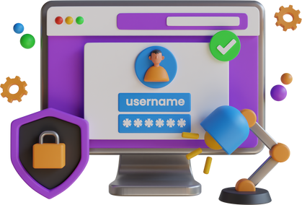
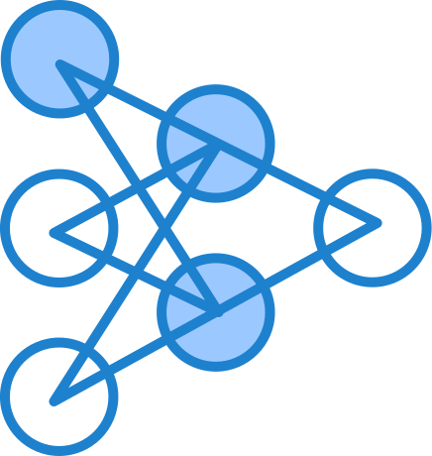

Jan
Project Timeline
Project Initiation: Define goals, requirements, and team roles.
Mar
Design and Development: Create wireframes and develop backend functionalities.
Apr
Database Integration: Set up a robust database system for user profiles.
Jun
User Registration: Implement a seamless registration process for new users.
Jul
Matchmaking Algorithm: Develop an intelligent algorithm for suggesting compatible matches.
Aug
Communication Features: Enable messaging and notifications for user interactions.
Sep
Launch and Testing: Perform testing, fix bugs, and deploy the Matrimony Web Service.
Page: 29

Slide 32
Webpage View
Page: 30

Slide 33
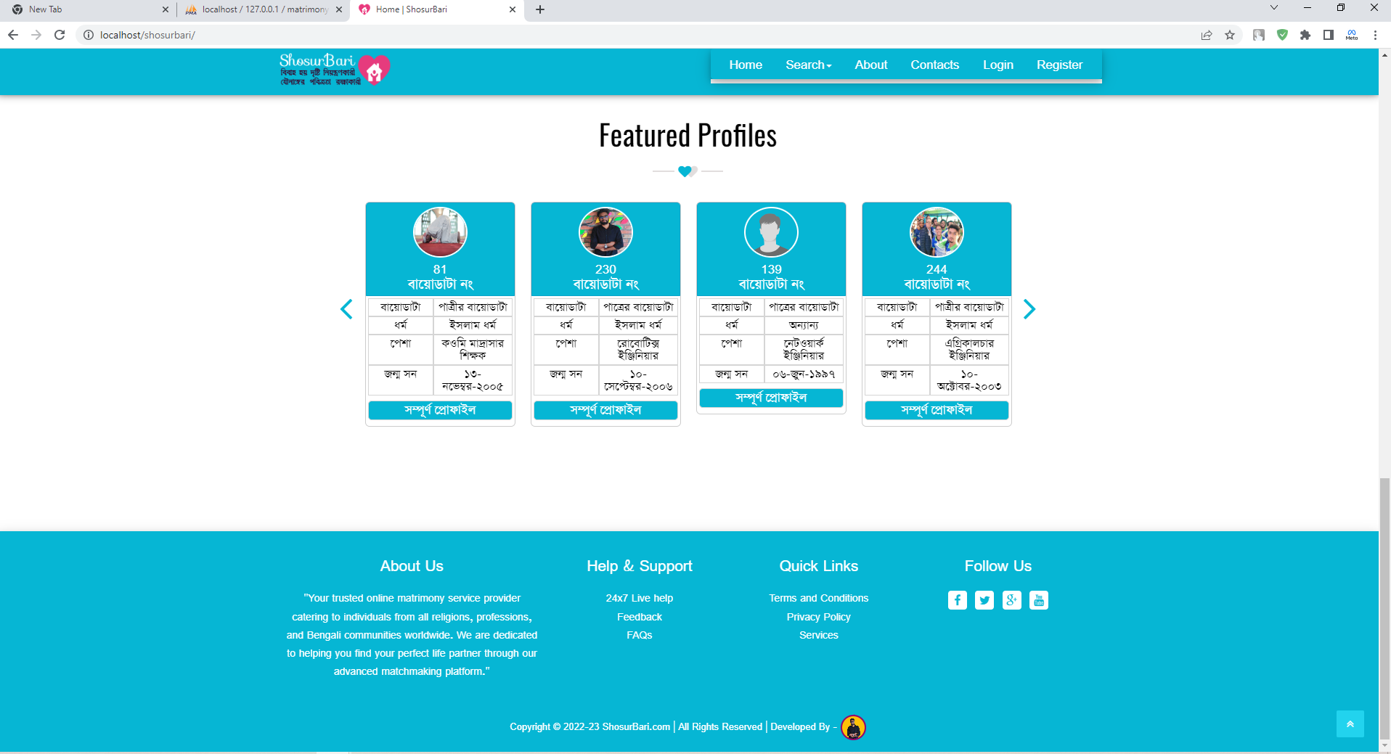
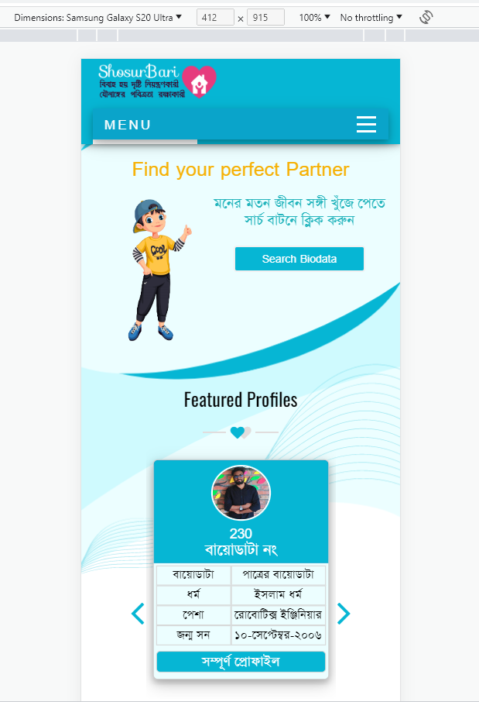
Home Page
Width Screen
Mobile Responsive
Page: 31

Slide 34
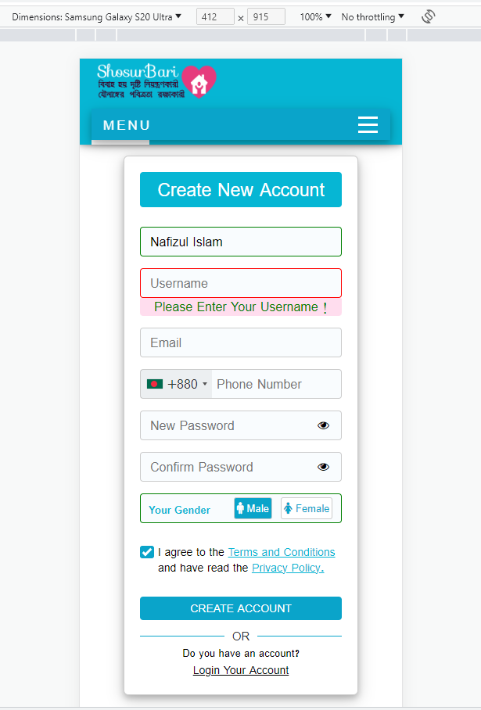
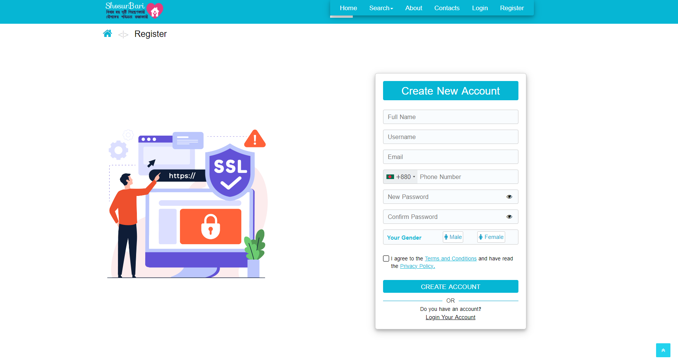
Registration Form
Width Screen
Mobile Responsive
Page: 33

Slide 35
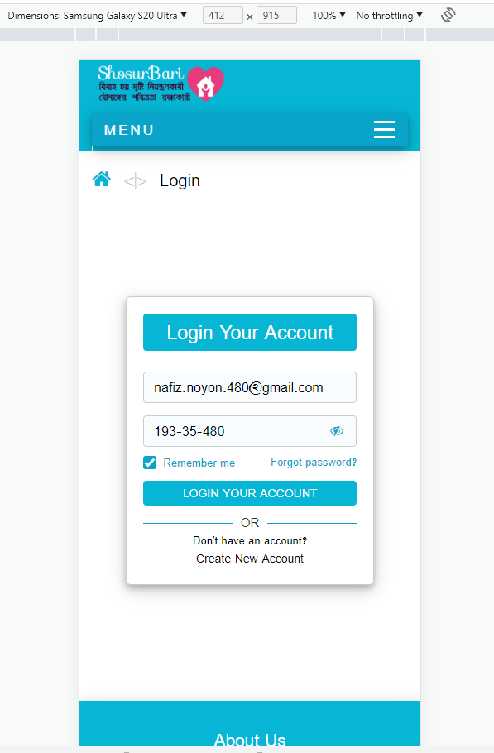
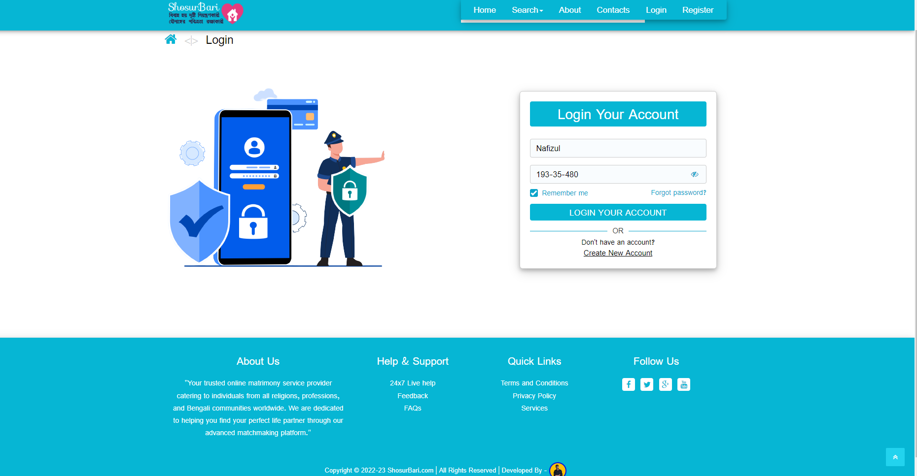
Login Form
Width Screen
Mobile Responsive
Page: 34

Slide 36
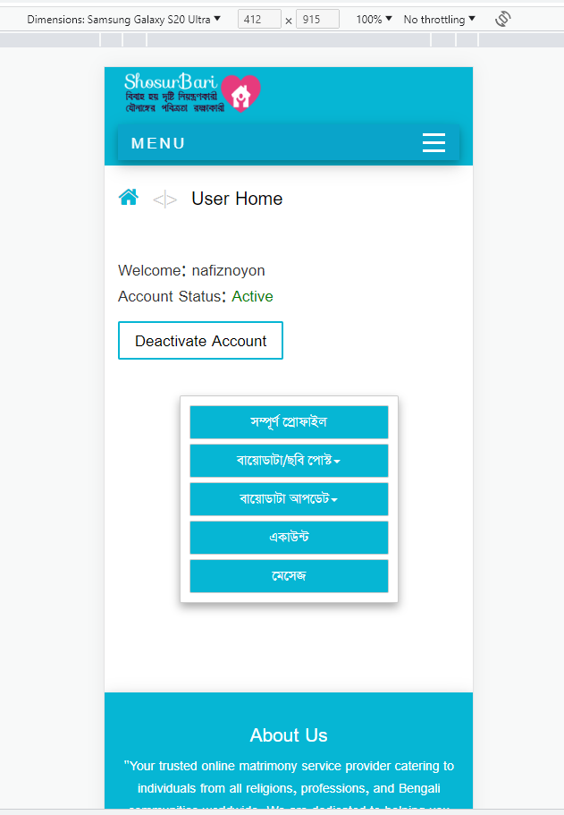
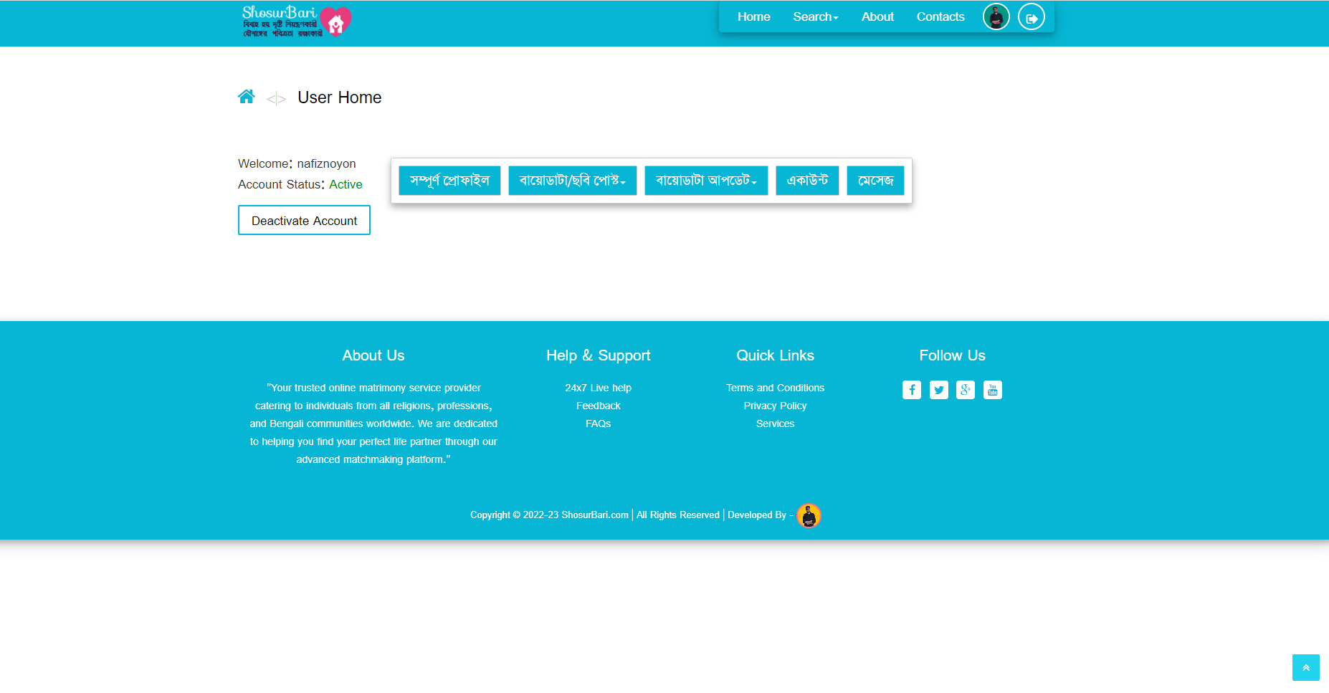
Reg. Member Home Page
Width Screen
Mobile Responsive
Page: 35

Slide 37
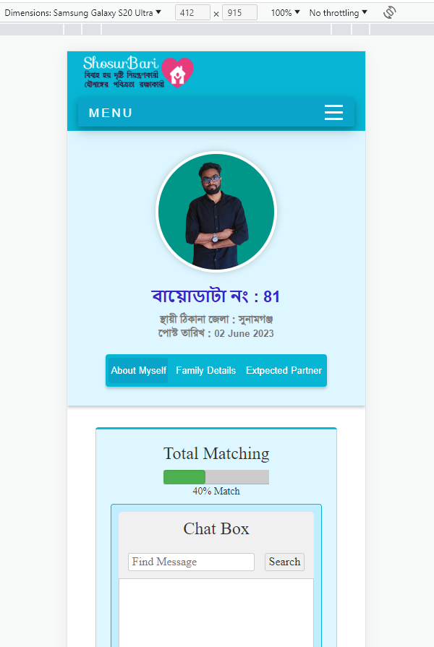
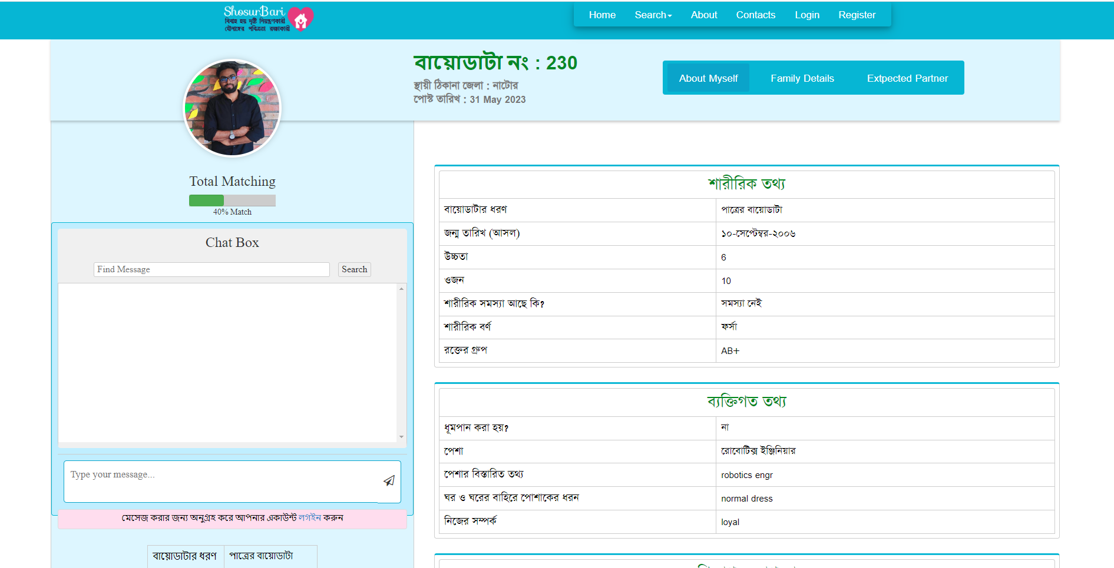
Groom Bride Profile
Width Screen
Mobile Responsive
Page: 36

Slide 38
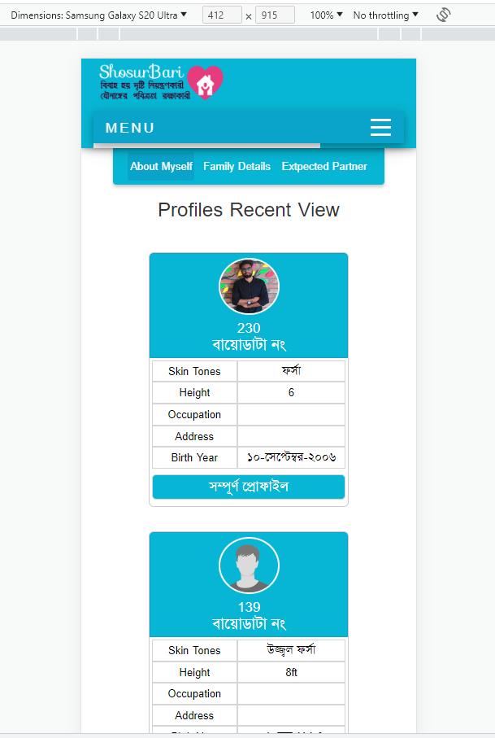
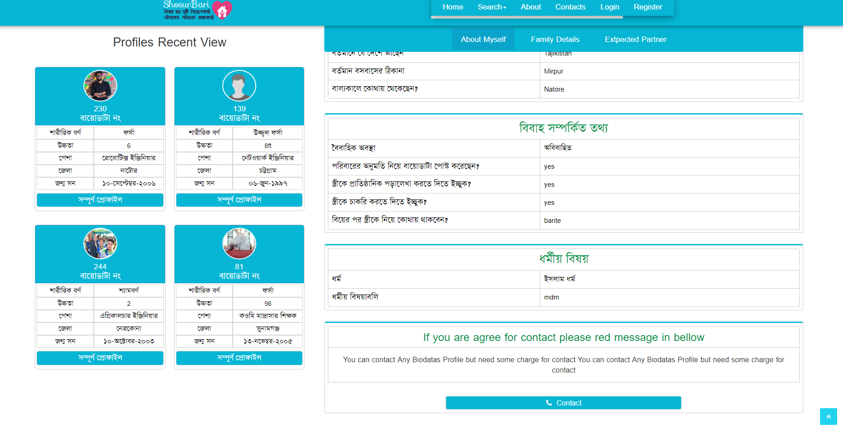
Show Profile Recent View
Width Screen
Mobile Responsive
Page: 37

Slide 39
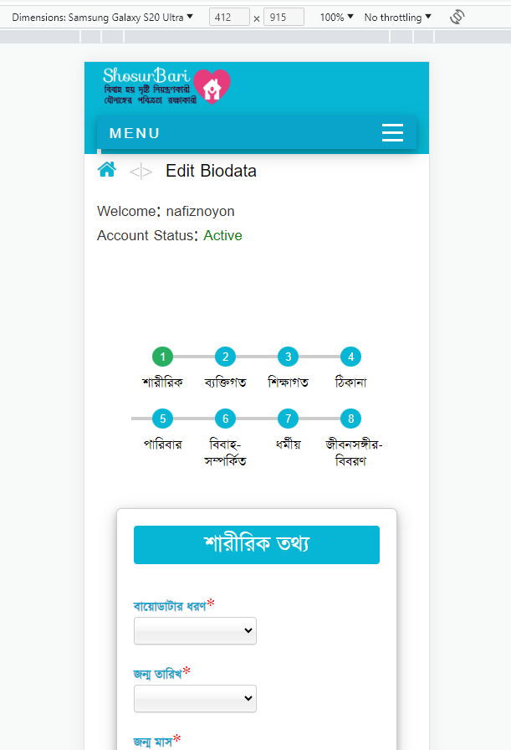
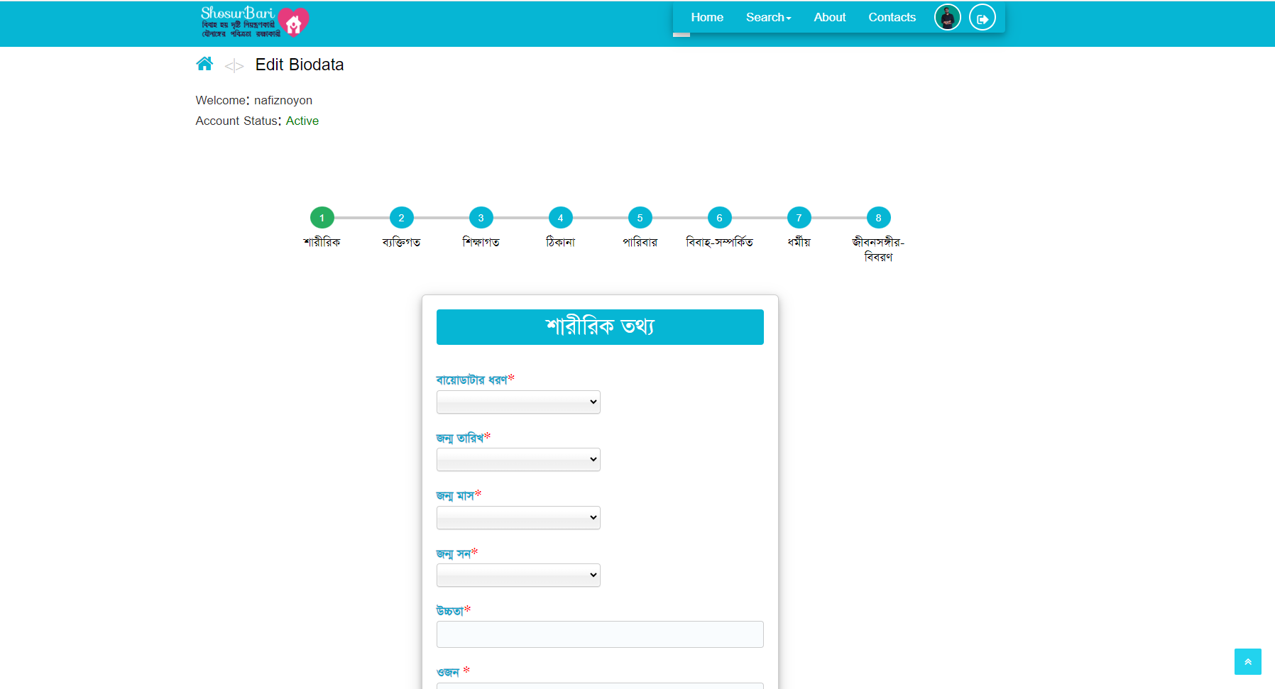
Biodata Post Form Page
Width Screen
Mobile Responsive
Page: 38

Slide 40
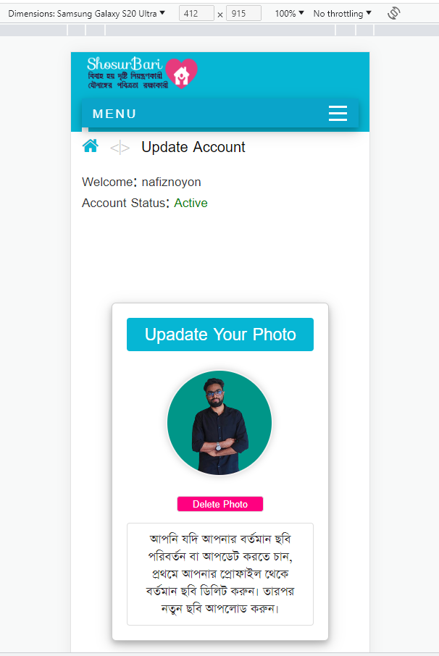
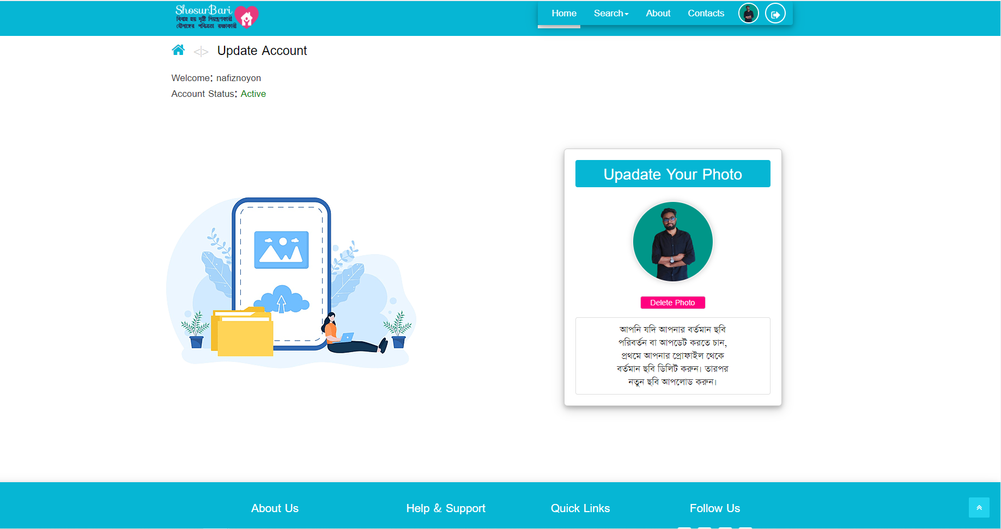
Biodata Post Form Page
Width Screen
Mobile Responsive
Page: 39

Slide 41
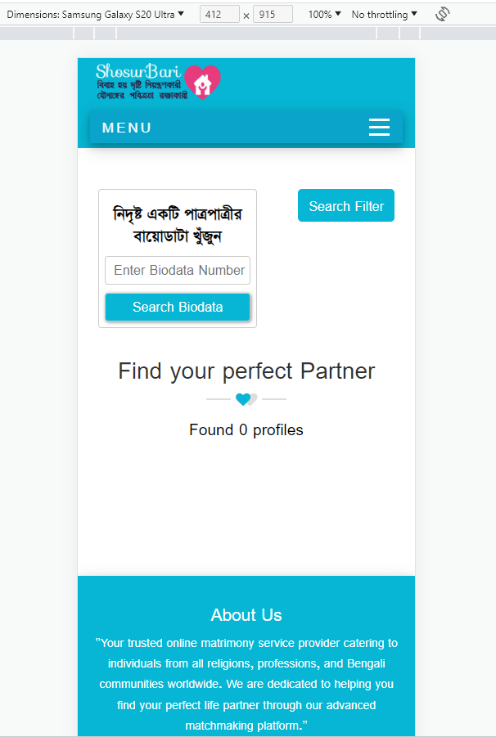
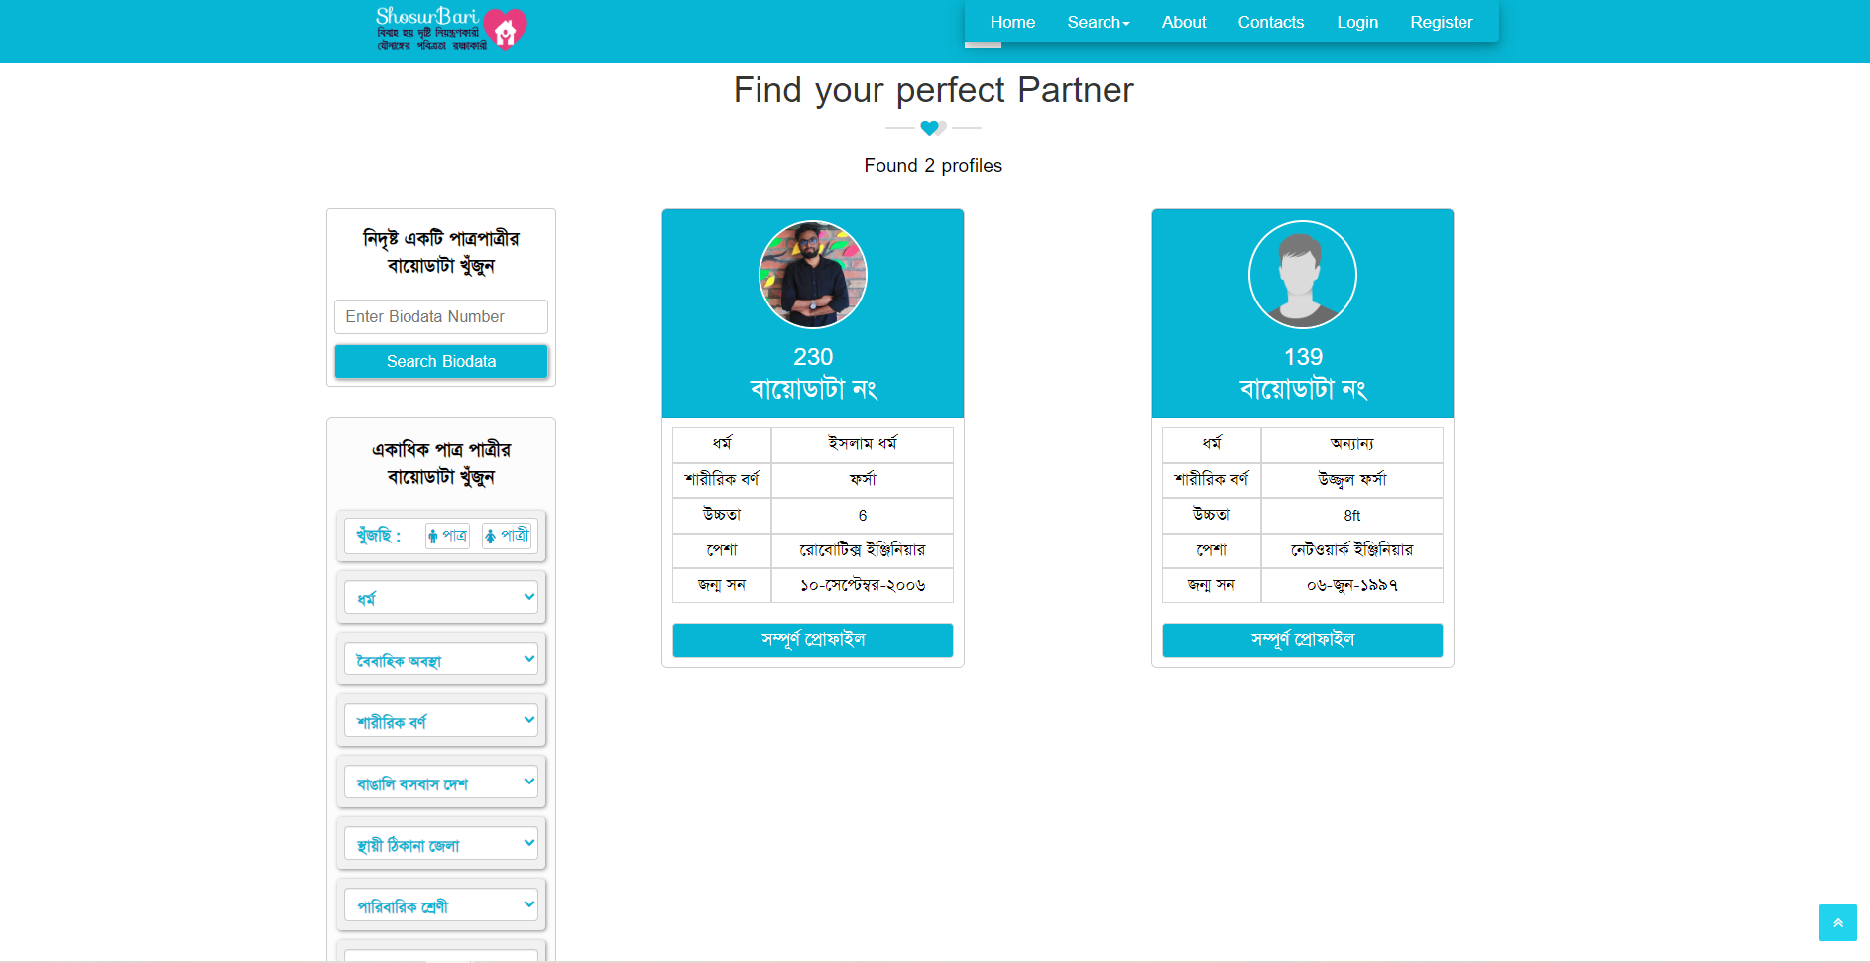
Groom Bride Search
Width Screen
Mobile Responsive
Page: 40

Slide 42
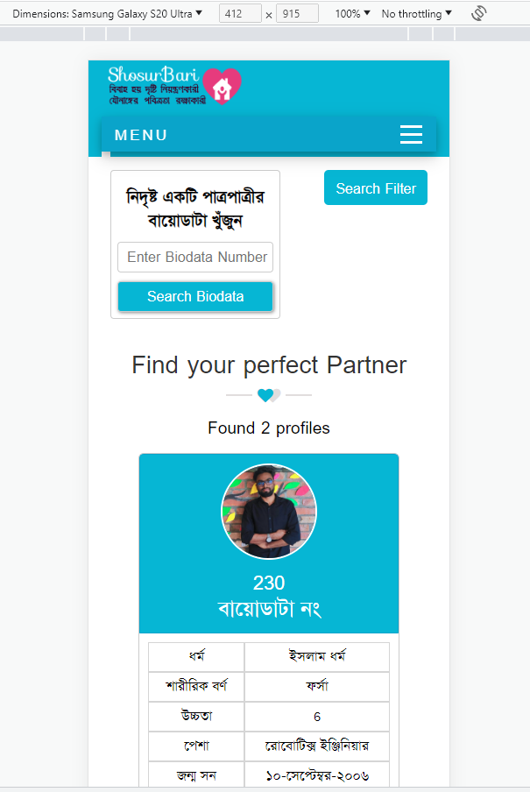
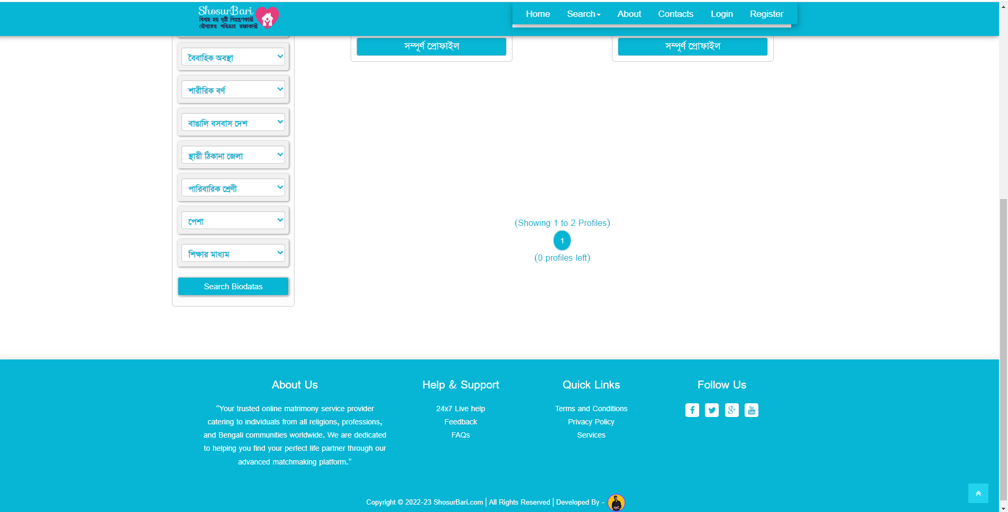
Groom Bride Search
Width Screen
Mobile Responsive
Page: 41

Slide 43
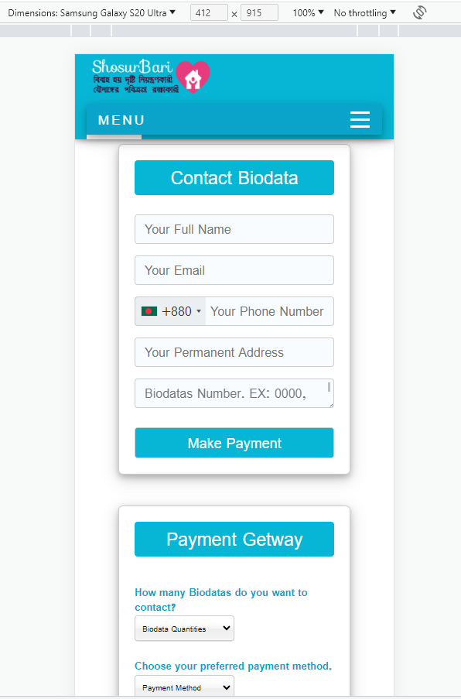
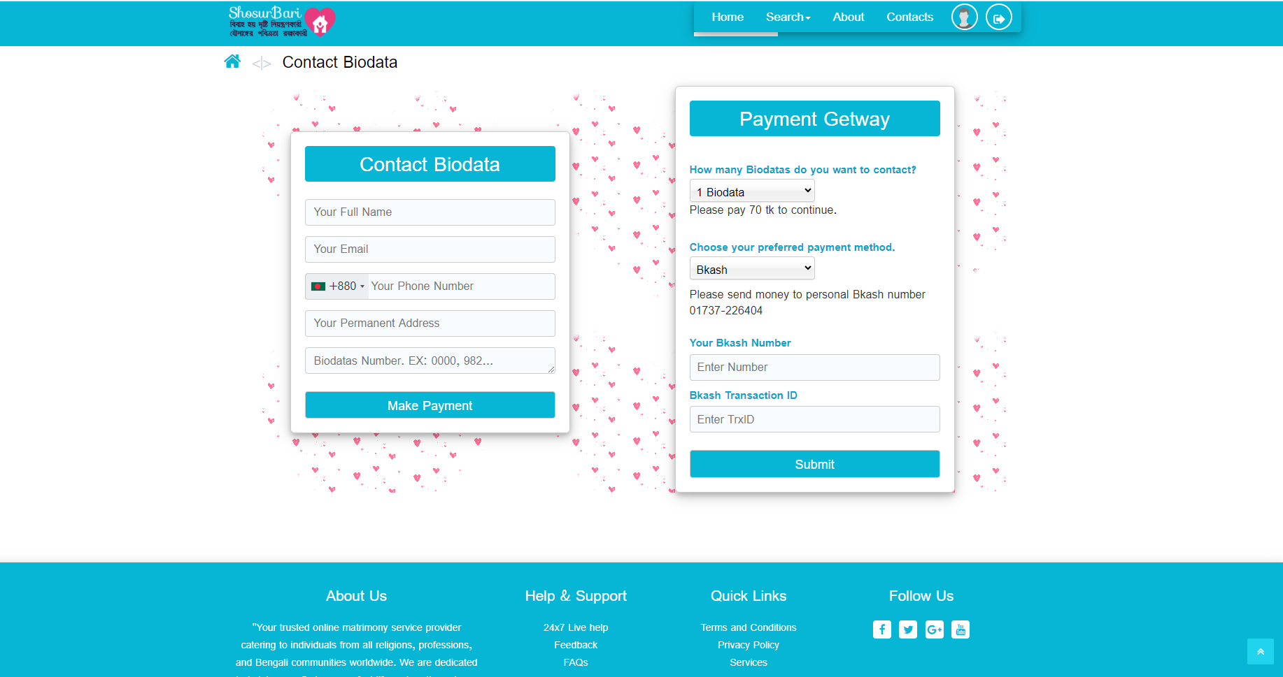
Manual Payment Form
Width Screen
Mobile Responsive
Page: 42

Slide 44
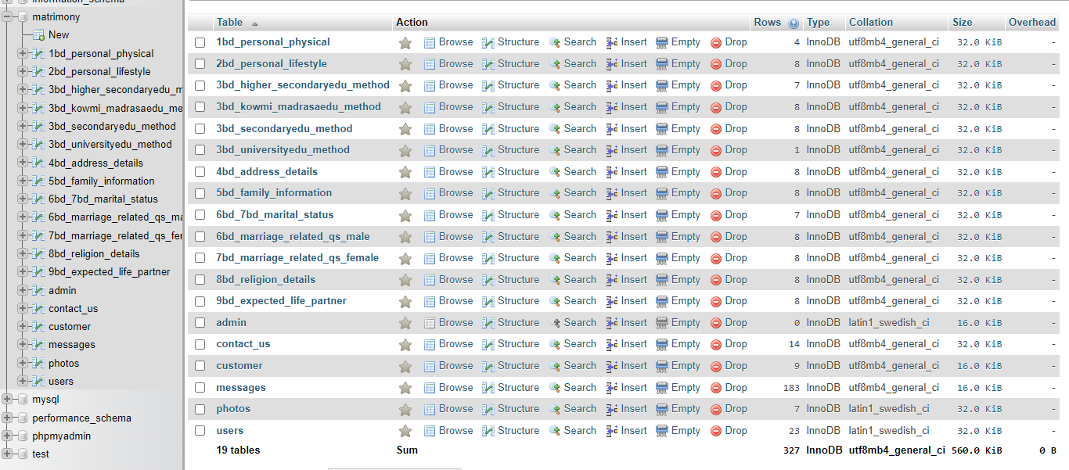
Database
Page: 43

Slide 45
Reference: I draw all diagrams
https://www.freeprojectz.com/uml-diagram/marrige-buero-management-system-uml-diagram?
https://www.slideshare.net/parthgbhatt/rab-ne-bana-di-jodi-online-matrimonial
https://www.academia.edu/43102557/SRS_Matrimonial_Website
https://www.lovelycoding.org/online-matrimonial-management-system/
https://creately.com/diagram/example/jrkstpdb2/admin-activity-classic
https://meeraacademy.com/activity-diagram-for-matrimonial-website-project/
Competitor:
https://www.bangladeshimatrimony.com
https://www.taslimamarriagemedia.com
https://www.bdmarriage.com
https://ordhekdeen.com
https://borbodhu.com
Page: 44

Slide 46
THANK YOU
End

